Slide 1

Orange Fanta
Interim Project
SGUP-CT BIDA Junior Data Engineer Programme
14 October 2021

Slide 2


Introduction
We are an IT Solutions company established in Aug 2021
Orange Fanta Technology Co. Ltd
Drink Fanta Do Data!
Data Engineering Team
Team Manager: Alan
Team Supervisor: Johnson
Jr Data Engineers: Anisa, Li Jia & Vani

Slide 3


Project Goals
Twitter is a social media platform where people communicate with one another using 280-character tweets, images, videos and hashtags. Users on Twitter are generating about half billion tweets every day. Some of these tweets are available to researchers and developers through Twitter's public APIs and other methods dependable on which language we are using.
In this project, we are tasked to collect different types of data from Twitter, build and store the scraped data in a database.
Explore the web and select appropriate open-source libraries to help solve the above project.
Install PostgreSQL in our environment and design the database schema, tables and entity relationship model (ERD).
Apply SQL in Python to insert, update and view crawled data in the database.

Slide 4






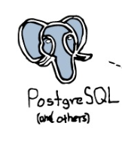

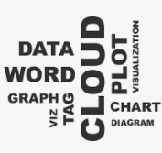


Architectural Design
Connecting
Data
Scrubbing
Data & DB
Processing
Visualising
Analysing
Storing
Tokenising

Slide 5
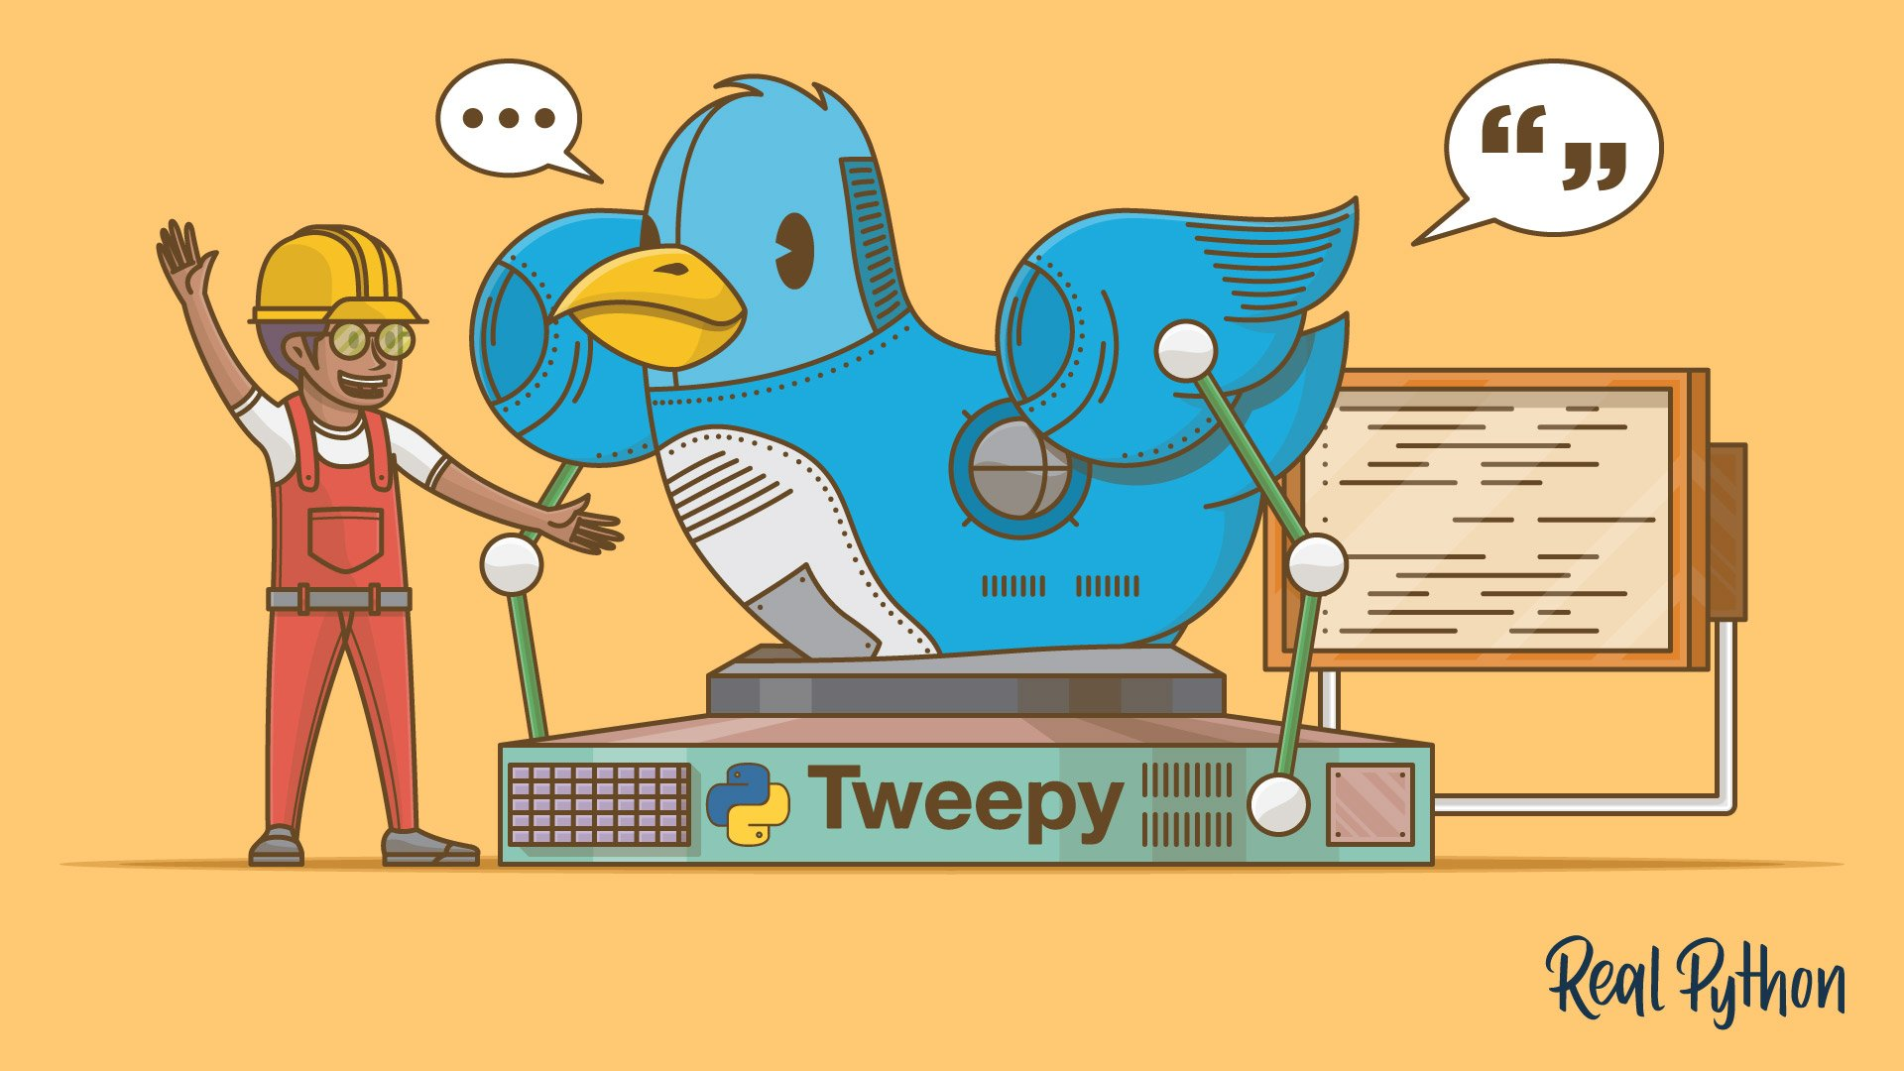
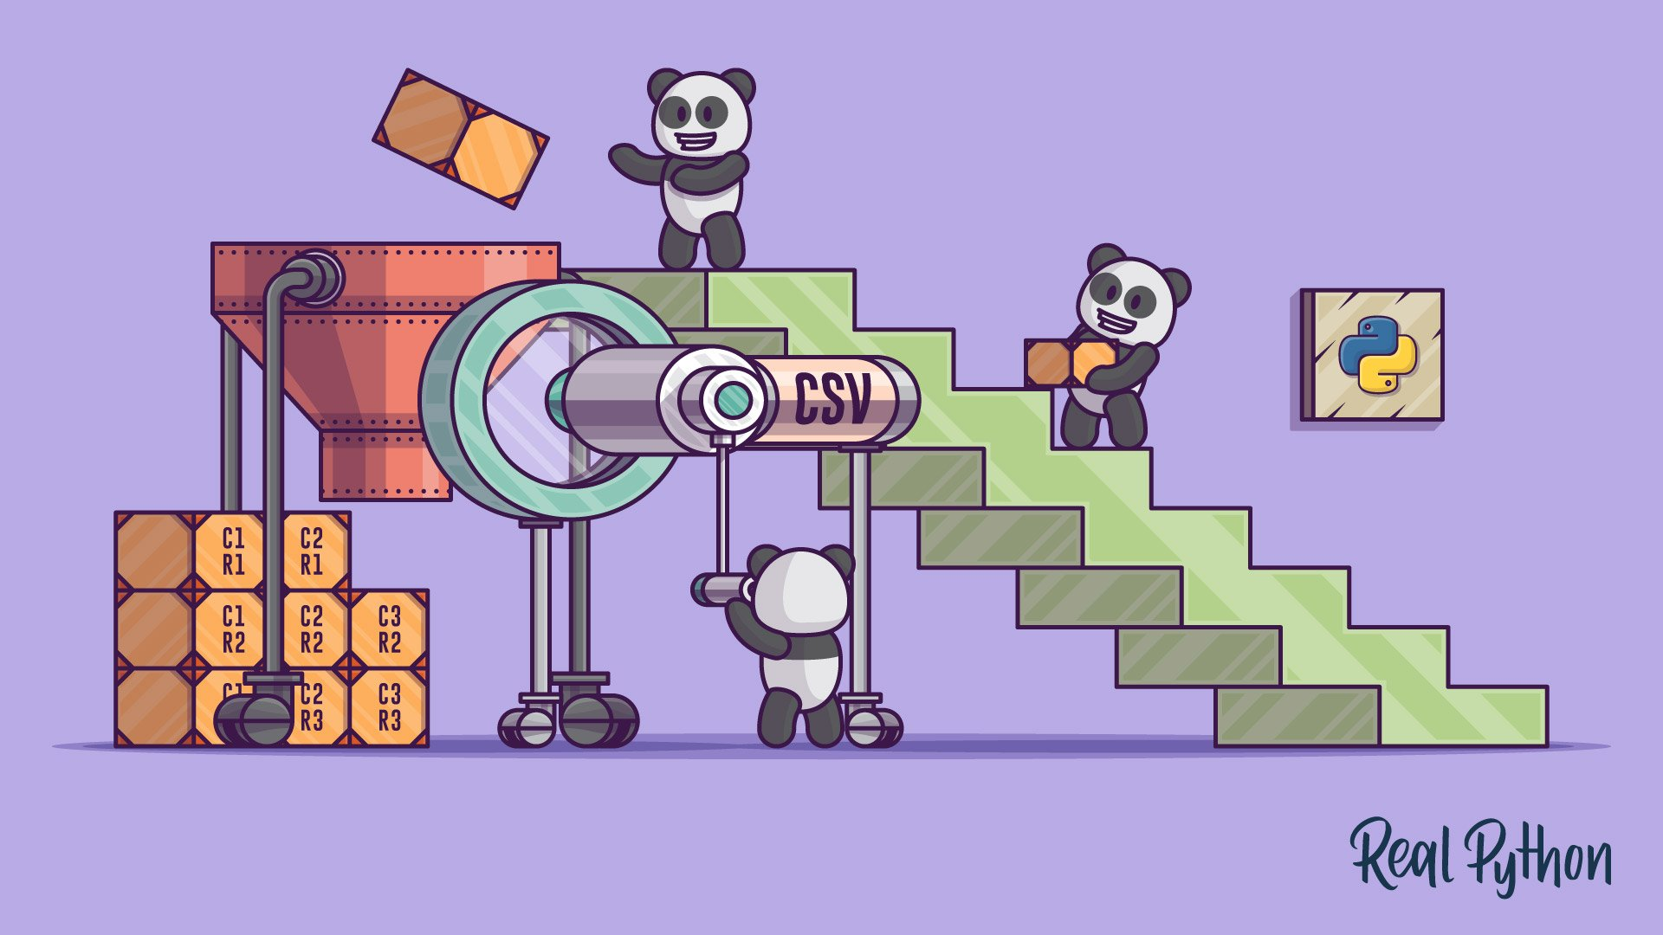
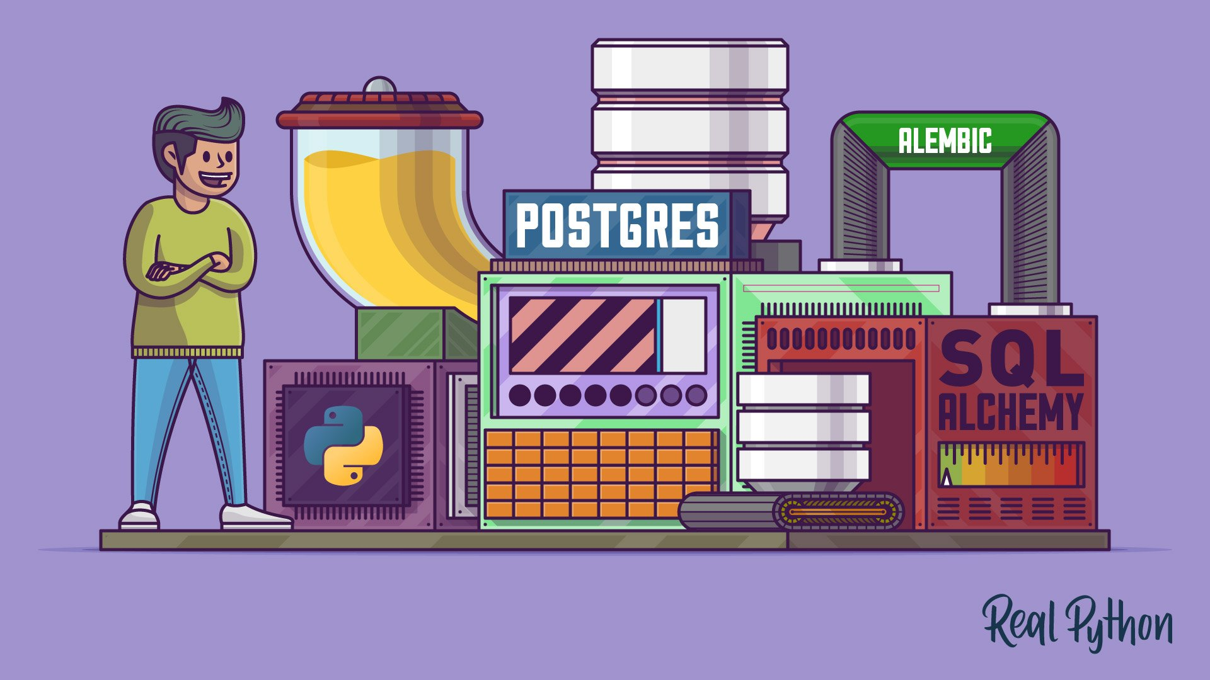


Libraries & Tools
Tweepy To access Twitter APIs
Pandas To perform data analysis
Psycopg2 To connect to PostgreSQL DB
Wordcloud To visualise usage frequency of text
NLTK To tokenise text
Matplotlib To graphically plot data
SQLAlchemy To connect Python & PostgreSQL DB
Python 3.9 To programme codes
pgAdmin 4 v5 To administer database
Collaboration Tools
Microsoft Teams
Google Docs, Google Colab, Google Drive

Slide 6

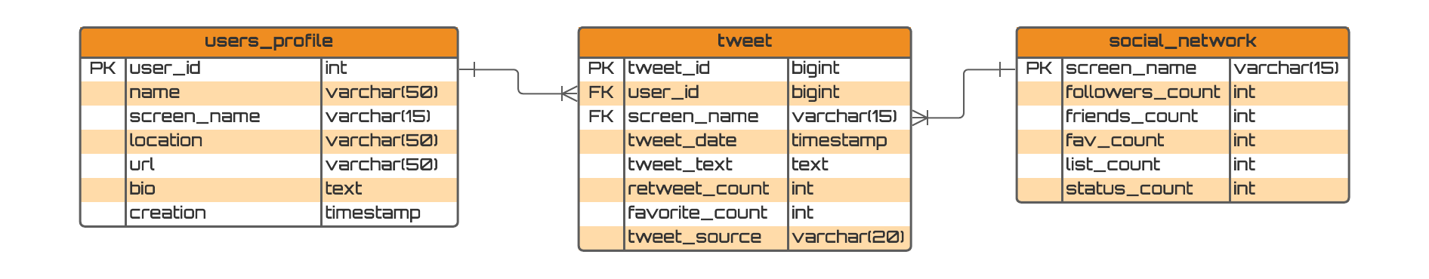
Entity Relationship Diagram (ERD)

Slide 7

Problem Statement
1) Problems encountered in Jupyter Notebook
Had problems installing Tweepy 4.1.0 version. Runtime errors occurred when connecting to Twitter API v1.1 from Jupyter Notebook. The troubleshooting process took a long time after the recent release of the version. The changelog notes are still being released at Github. So started using Google Colab.
2) Errors encountered in getting local connection on Colab
Server Extension error in Anaconda Prompt
Jupyter Notebook won't start due to ports being already in use – ‘The port 8888 is already in use, trying another port’
3) Tweepy API Bug
Tweepy returns an error if we try to input a second set of data into PostgreSQL. Data will be recorded although the error still occurs. More information about the error is recorded in this link:
https://stackoverflow.com/questions/4448340/postgresql-duplicate-key-violates-unique-constraint

Slide 8

Our Solutions
1) Migrating from Jupyter Notebook to Google Colab
Google Colaboratory or Colab is a free Jupyter-like environment that runs in the cloud and stores its notebooks on Google Drive and can be loaded from GitHub. Jupyter notebooks and Colab notebooks can be opened interchangeably on both platforms. Like Jupyter notebook, Colab notebook can be shared easily like Google Docs.
2) Updating Server Extension
For first-time users, please update Server Extension in Anaconda Prompt. User Guide is available for reference.
Retry by using another port instead, 8886.
3) Bug Solution not required
Data was recorded, so ignored the error.

Slide 9



Our Products and Services
Products
Twitter Data Crawler USD 2999.00
Google Colab User Guide USD 999.00
Services
Twitter Data Crawling Service and Analysis Report USD 6888.00 (Standard Package)
Twitter Data Crawling Service with Extensive Analysis Report USD 9888.00 (Premium Package)
Additional Specification Requirements & Personalisation NEGOTIABLE (Ultimate Package)

Slide 10




Thank you!
Any Questions?

